Slide 1
Second Hand Cars Analysis Project
Bashayer Alshehri,saud alasmri

Slide 2
project definition
Second Hand Cars Analysis Project :second hand cars market
This project helps most people in real life to save money buying a used Car as it saves almost 50% lower than new cars, no exaggerated fees, lower insurance, and lower annual registration fees.
it contains most relevant information that provides on car sales including columns :Car name, year, Sell Price, Driven - km, Owner , Mileage, and etc.
Start with a question:
Do people need help to get analyzed data about Used Cars before Buying? In my point YES, most people need help to get analyzed data about the used cars before buying them so It’s important to know the price and kms driven on the car as well as the brand to know if the car is a good purchase for second hand owner or not. This data can help many people reach to that conclusion.

Slide 3
Tooles
Dataset
its Regression data and its contain 13 columns and 8127 rows (8127, 13)
(car-details?select=Car_details.csv) from https://www.kaggle.com/datasets
Libraries
Data processing: pandas ,numpy
Visualization: matplotlib ,seaborn , plotly
Modeling: sklearn
programing language :Python
Modling
Linear Regression

Slide 4
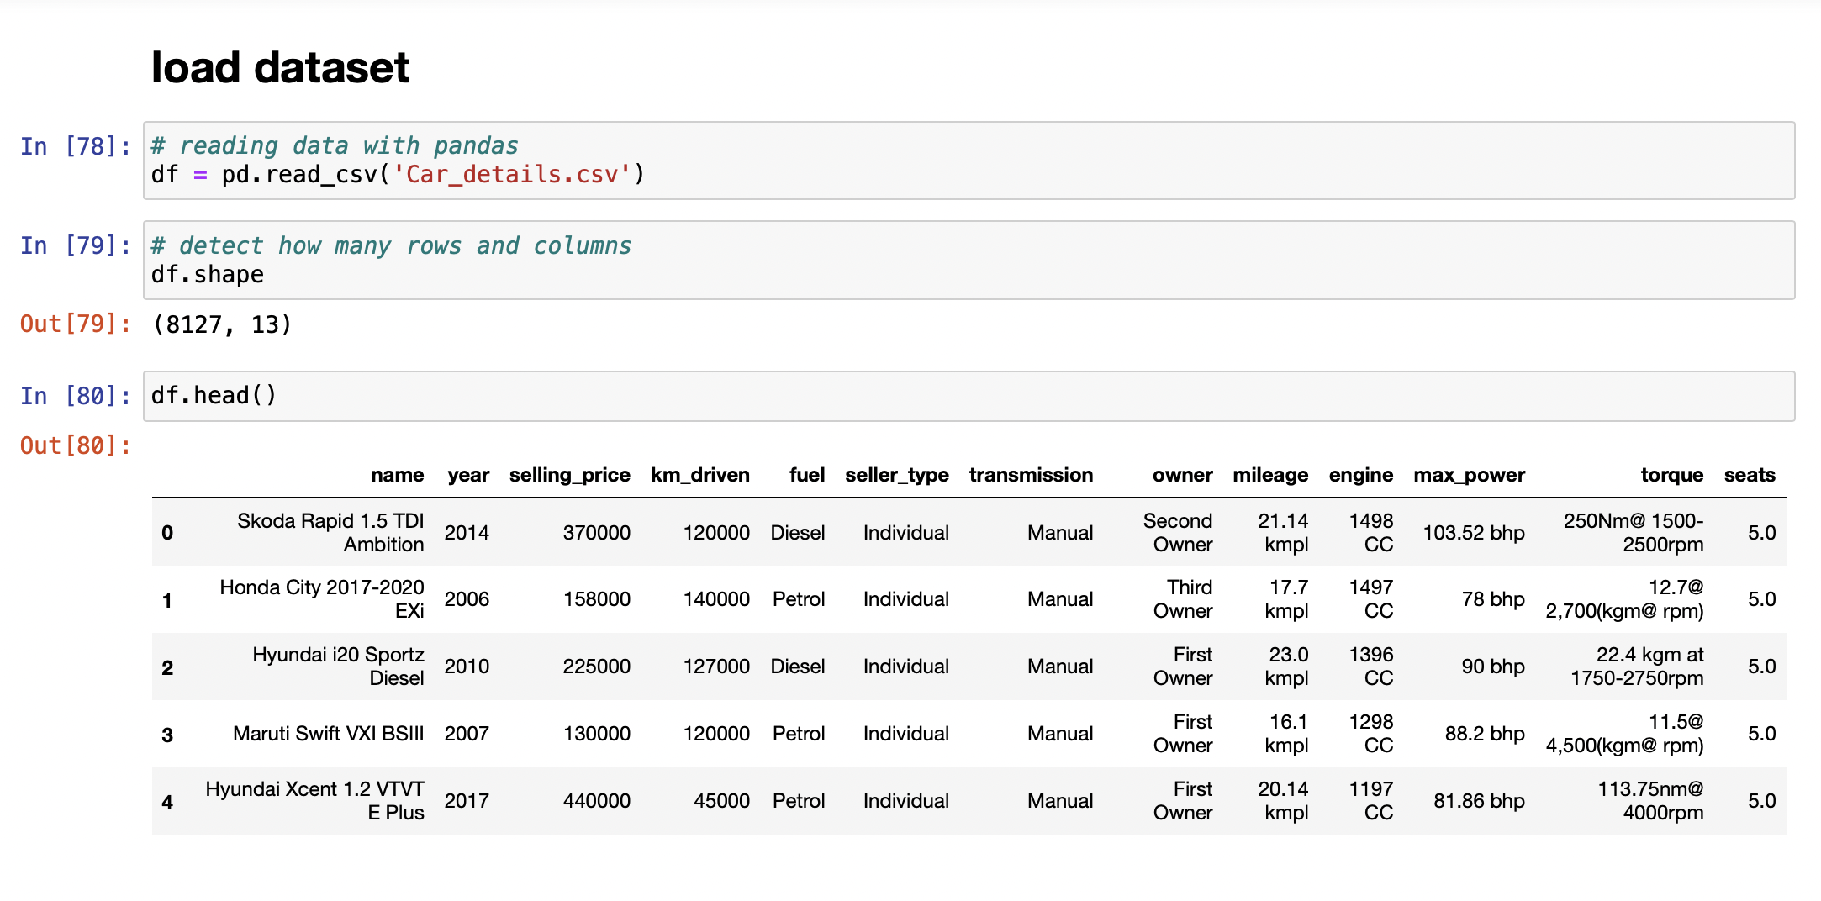
After import Libraries we follow the following steps:
1.read_data

Slide 5
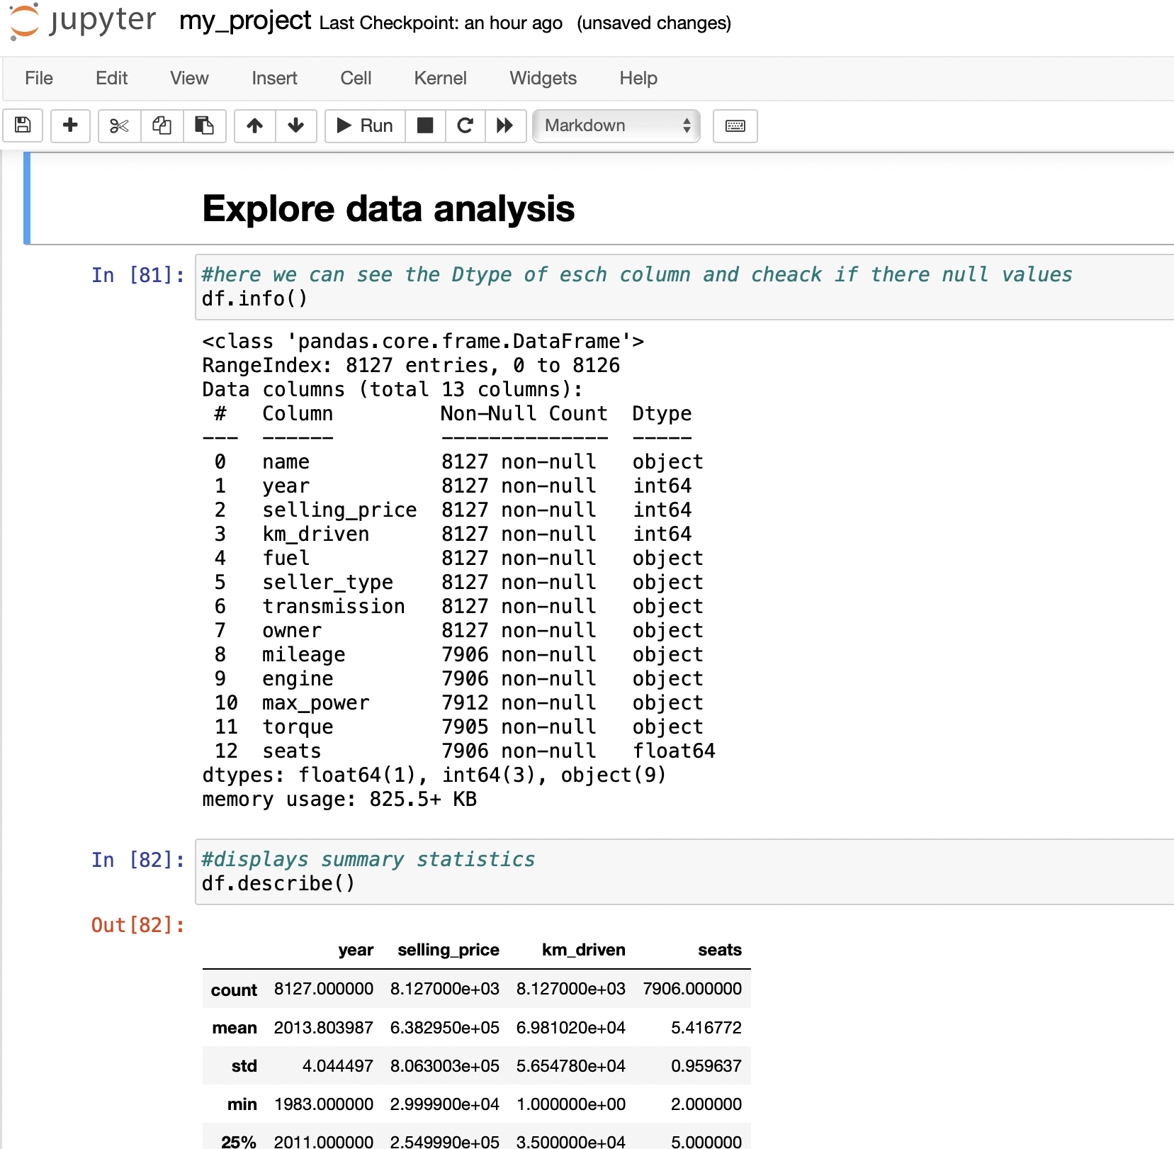
2.Explore data analysis
We explore the data
By see data type of each column and check if there is null values (found the last 5 columns has null values)
And the summary statistics using describe ….

Slide 6
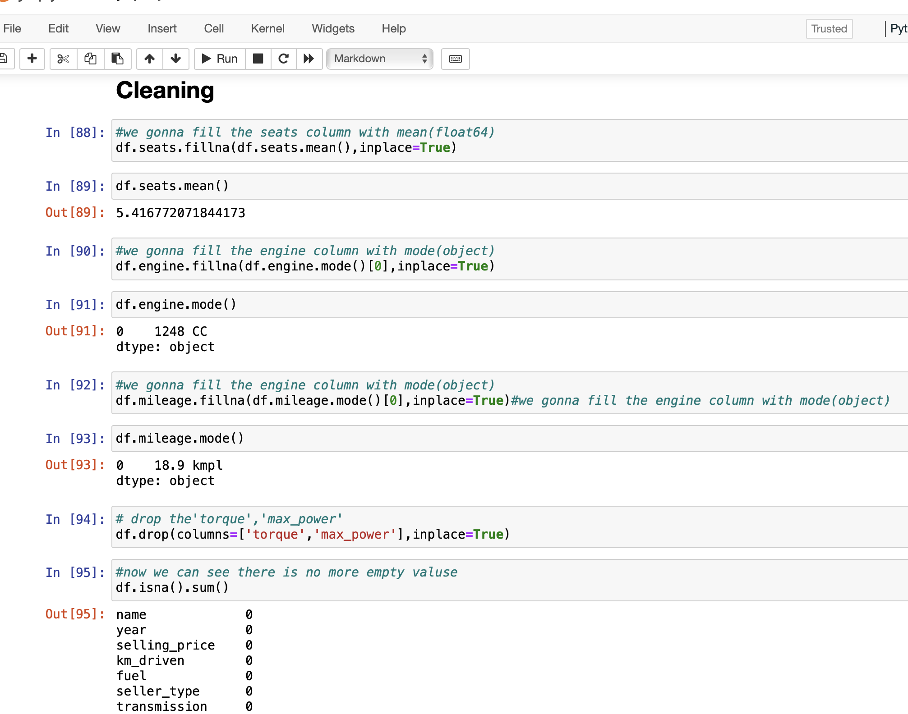
3.Cleaning
Clean dataset using some method like drobing the null valuse or fill it
Remove the duplicated (we found 1202)
after we clean our dataset the num of the columns and rows changed (6925, 11)

Slide 7
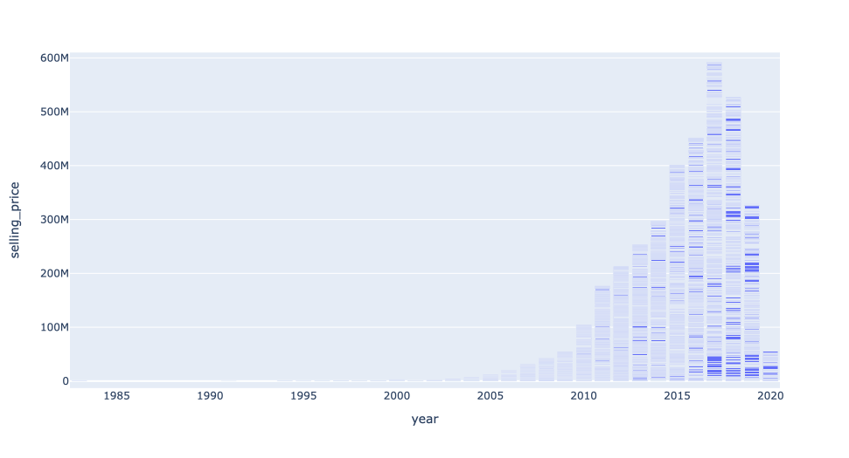
4.visualization
We use the bar chart to represent count of selling prices in every year

Slide 8
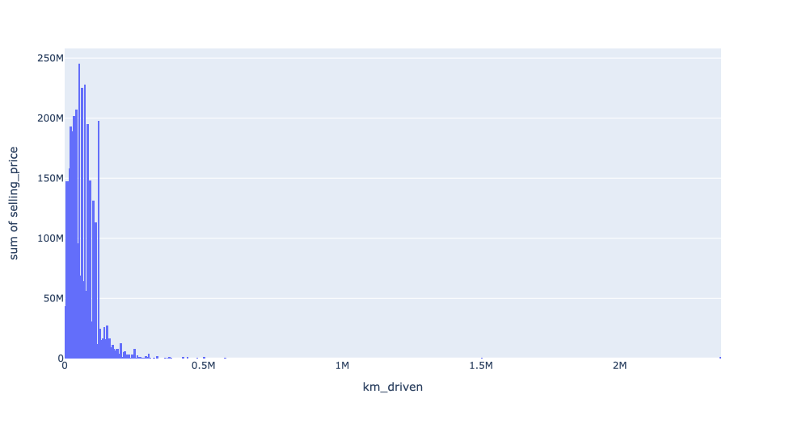
Using the histogram to represent count of selling prices according to it's km_driven

Slide 9
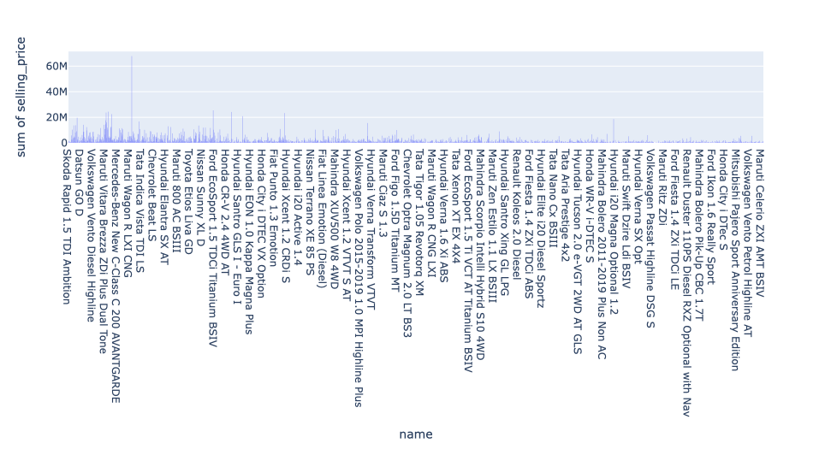
Using the bar chart
to represent the sum of selling_price
for each cars

Slide 10
5.Modeling
preprocessing for modeling
convert character columns to dummy variables to be ready for the modeling
df=pd.get_dummies(df)
split Data
detect input and output and split train test
feature scaling
scal all the feature to same scal
apply LinearRegression model

Slide 11
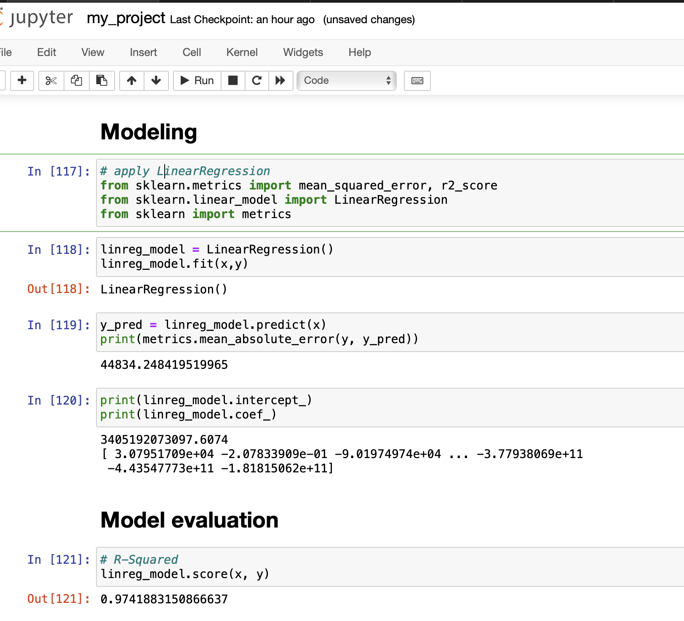
6.Model evaluation
# R-Squared
linreg_model.score(x, y)

